Slide 1



Mobile FaceNet
Sajad Ghadiri
Mahya Haghgoo
Maral Mordad
Mohammad Barabadi

Slide 2
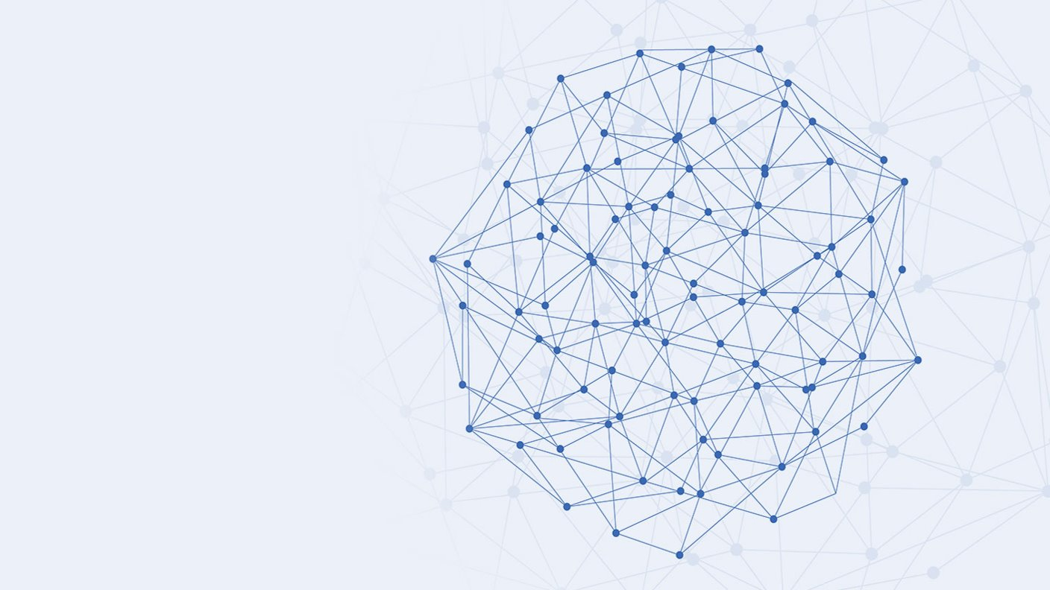
Why CNN?
Number of neurons
Faster in image applications & …
Less parameters

Slide 3
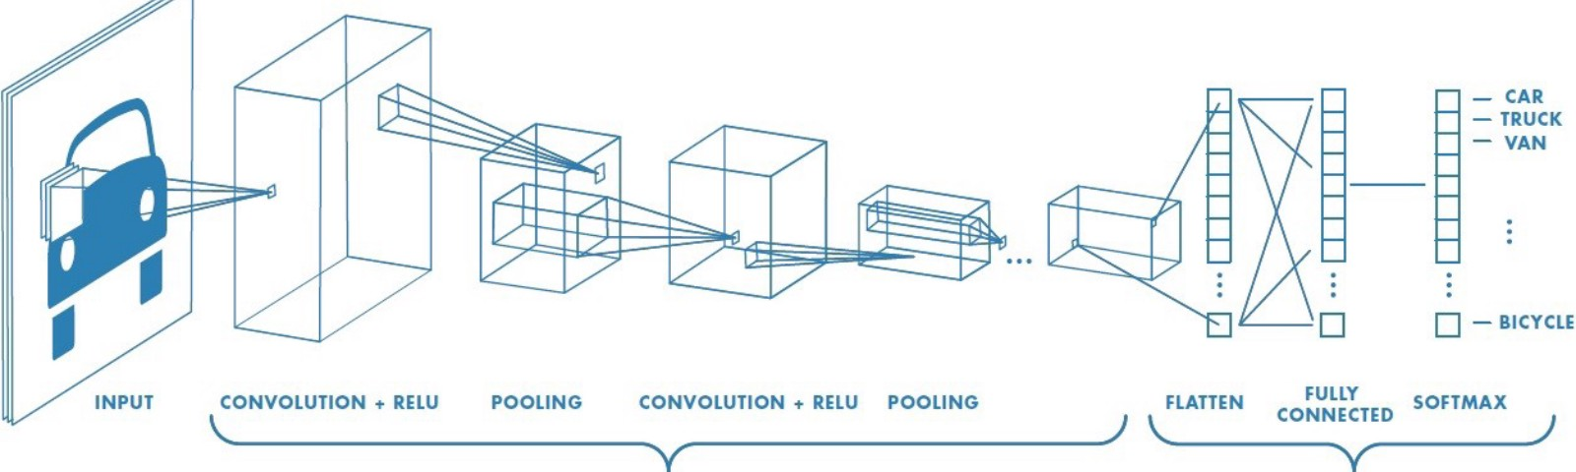
CNN architecture
Notes:
AT MSFT , we are investing in 3 key areas –
Ai Platform – New capabilities , security, integrations, open source, out of the box investments
Infusing AI – Infuse AI to all applications – think Excel, PowerPoint, Azure
Business Solutions – Dynamics, O365

Slide 4
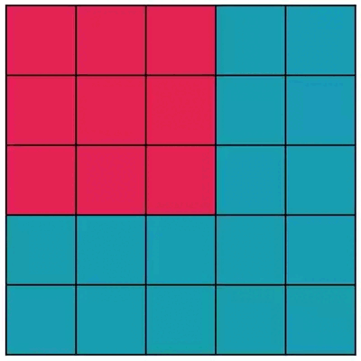
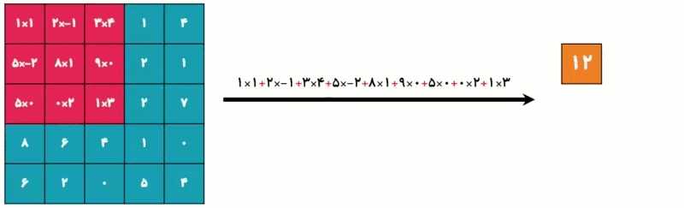
convolution
Filter assign a number instead of each window
Strides of filter can be adjust
Output dimension will be set by dimension of filter and input
Output dimension can be equal to input dimension by changing input dimension with some “ padding method ” like zero padding

Slide 5

convolution
Multilayer input convolved with filter and merged to 1 layer output

Slide 6
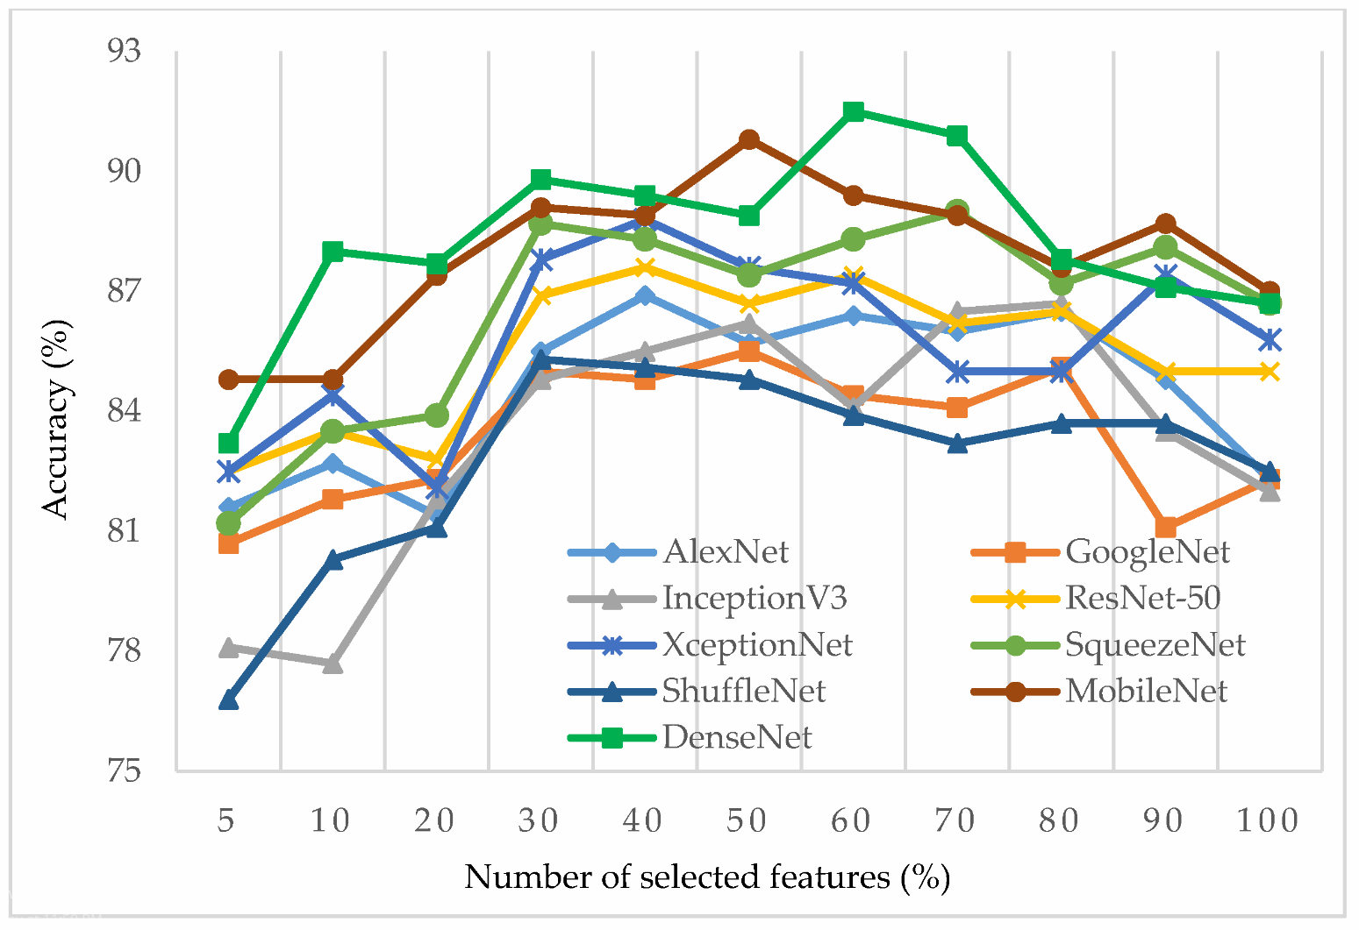
Brief Background

Slide 7
MobileFacenet VS Mobilenet
Different Datasets
MobileFacenet has more efficient Loss function than Mobilenet
Mobile network has crop limit which means that you should give the network cropped pictures, so its not good enough in practical.
Although mobile Facenet has no limitation on crop issue .
Notes:
AT MSFT , we are investing in 3 key areas –
Ai Platform – New capabilities , security, integrations, open source, out of the box investments
Infusing AI – Infuse AI to all applications – think Excel, PowerPoint, Azure
Business Solutions – Dynamics, O365

Slide 8

Mobilenet
Depth-wise separable convolution
1. we only have 1 kernel.
2. we use another way for merging output of filters which named point-wise convolution
Notes:
AT MSFT , we are investing in 3 key areas –
Ai Platform – New capabilities , security, integrations, open source, out of the box investments
Infusing AI – Infuse AI to all applications – think Excel, PowerPoint, Azure
Business Solutions – Dynamics, O365

Slide 9
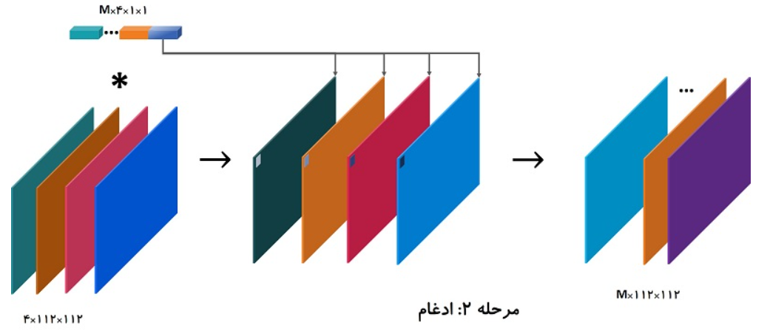
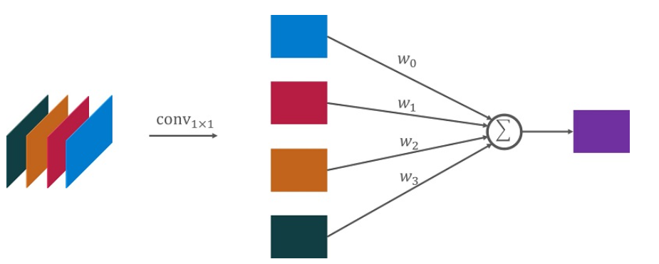
Mobilenet
Point-wise convolution
1*1 convolution which has M kernels and each layer of
kernel merges with some weight
Notes:
AT MSFT , we are investing in 3 key areas –
Ai Platform – New capabilities , security, integrations, open source, out of the box investments
Infusing AI – Infuse AI to all applications – think Excel, PowerPoint, Azure
Business Solutions – Dynamics, O365

Slide 10
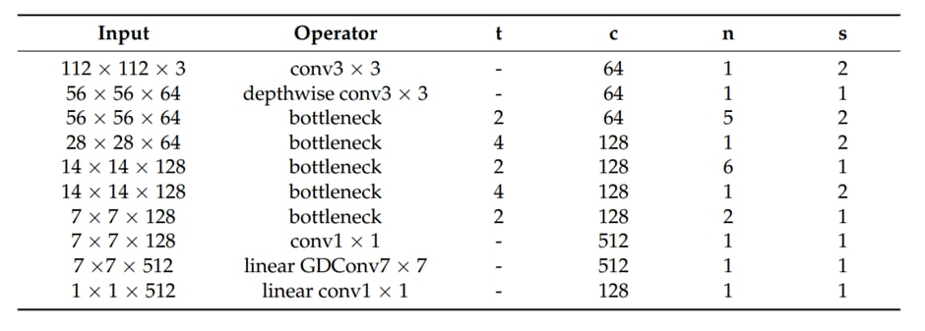
Mobile FaceNet architecture

Slide 11
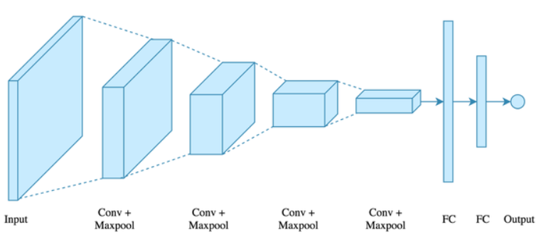
Some points
Some layer don’t have weight and parameter so they never learn and they don’t have update like Max Pool or Batch normalization methods
Maxpooling ( 2*2 filter which calculates maximum of convolution window )
Batch normalization ( a method which normalize inputs in each layer in big networks )
Notes:
AT MSFT , we are investing in 3 key areas –
Ai Platform – New capabilities , security, integrations, open source, out of the box investments
Infusing AI – Infuse AI to all applications – think Excel, PowerPoint, Azure
Business Solutions – Dynamics, O365

Slide 12
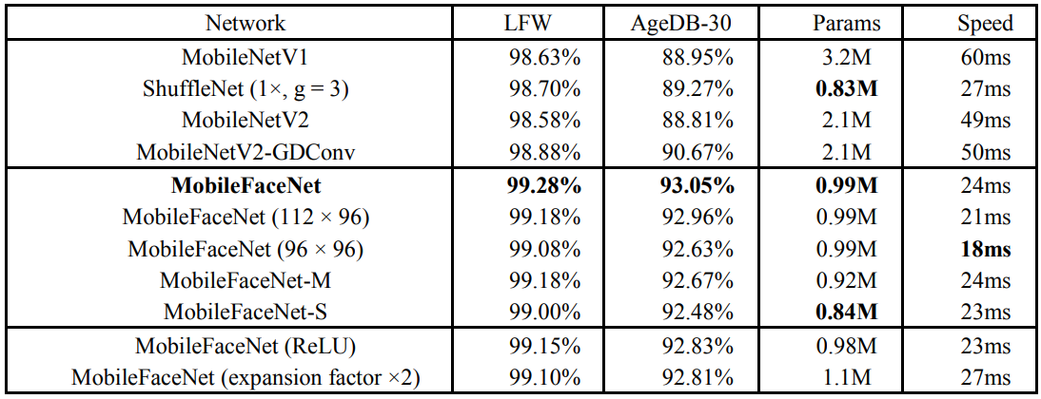
Performance comparison

Slide 13
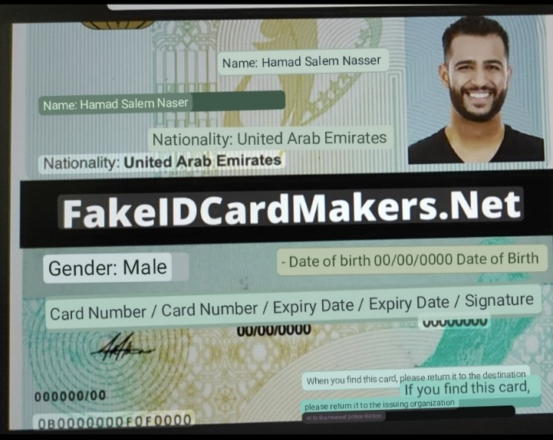

Google Lens
Notes:
AT MSFT , we are investing in 3 key areas –
Ai Platform – New capabilities , security, integrations, open source, out of the box investments
Infusing AI – Infuse AI to all applications – think Excel, PowerPoint, Azure
Business Solutions – Dynamics, O365

Slide 14
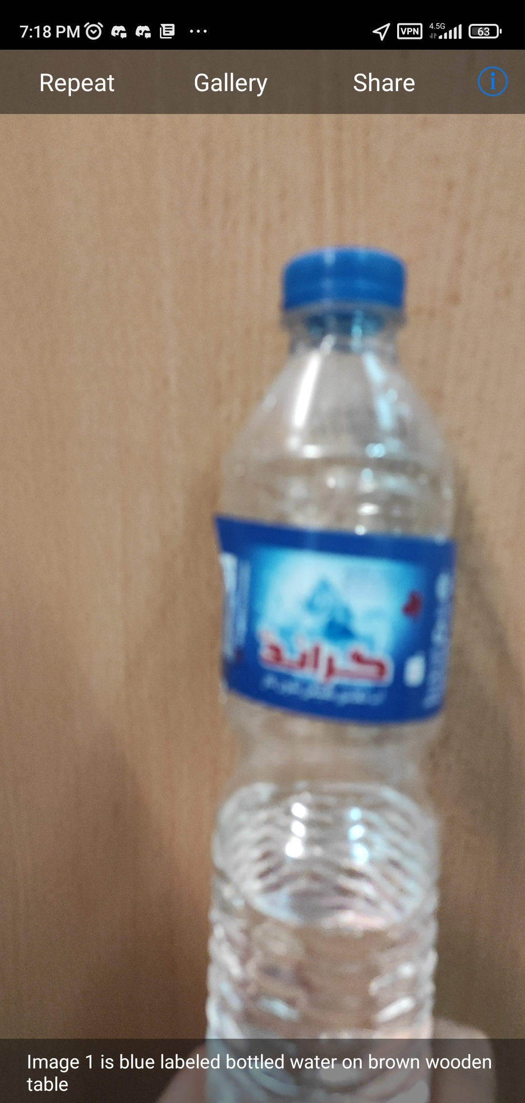
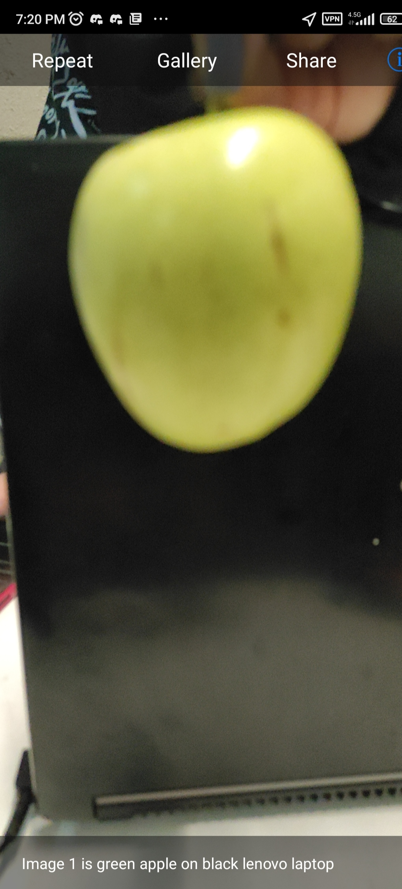
TapTap see
Notes:
AT MSFT , we are investing in 3 key areas –
Ai Platform – New capabilities , security, integrations, open source, out of the box investments
Infusing AI – Infuse AI to all applications – think Excel, PowerPoint, Azure
Business Solutions – Dynamics, O365

Slide 15
Thanks for your attention
Any Question?

